Slide 1


Create a blueprint
for financial success.
Learn how to set up a strong financial foundation to help you achieve your personal financial goals.
AR06436.082022 SMRU# 5027770.4 (Exp.09.20.2025)
Notes:
This presentation is designed for you to conduct in “workplace type” settings where you only have a limited amount of time with participants. The entire program should take about 20-25 minutes.
Timing: You should spend a minute or two welcoming the people and introducing yourself and spend 10-12 minutes conducting the main body of the seminar material. At the end of your presentation, you’ll want to reserve a couple of minutes to allow participants to complete the Evaluation Form.
Hello and welcome to “Create a Blueprint for Financial Success.” I am [name] an Agent from the [name] office of New York Life.
My role today is to provide you with information that can help you start to build a strong financial foundation that can help get you on the path to achieve your personal financial goals.
If at the end of the presentation you would like to have a discussion related to your specific situation, I’d be more than happy to help. Let’s get started.
The Script:
We’ve provided this script as a guide through the material. As with all sales language, you should first memorize this script through practice and repetition—then make it your own!

Slide 2
Welcome.
Carlo Mantica, MBA, RICP®, FSCP®
Financial Advisor offering investment advisory services through Eagle Strategies LLC, a Registered Investment Adviser
Registered Representative offering securities through NYLIFE Securities LLC (member FINRA/SIPC), A Licensed Insurance Agency
Eagle Strategies and NYLIFE Securities are New York Life Companies
CA Insurance License #4091406
Agent, New York Life Insurance
One World Trade Center, 285 Fulton Street, 39th Floor
New York, New York 10007
Tel. 917-498-1026, Email cmantica@ft.newyorklife.com
This presentation is not meant to be solicitation of investment products. Only properly licensed registered representatives of NYLIFE Securities LLC can offer investment products.
2

Slide 3
Disclosure statement.
This is an informational and life insurance sales presentation.
Please note that individual situations can vary.
Neither the information presented nor any opinion expressed
constitutes a solicitation for the purchase or sale of any
specific security.
Neither New York Life Insurance Company nor its agents or affiliates provide tax, legal or accounting advice.
Please consult your tax, legal or accounting professional before making any decisions.
3

Slide 4
Think of your finances as a house.
Your financial house.
4
Notes:
Today we are giving you the BIG PICTURE" of how to begin mapping out a financial blueprint for success--whether you chose to do it alone or with the help of a financial professional.
Today’s presentation is called “Create a Blueprint for Financial Success” because if you think about it, building a strong financial future is very similar to building a house—you start from the ground up.
First you have your plans or blueprint, then you lay a solid foundation. And you go from there.
For our purposes, we’ve segmented our financial house into a few core sections. We will get into specifics about each section in a few moments, but in general:
We start with protection and making sure you are covered for the uncertainties in life.
Then we talk about accumulation to help you prepare for the future—things like college funding and retirement planning.
Lastly, we’ll cover strategies to preserve your wealth throughout your retirement years.

Slide 5



Budgeting basics.
Household
income
Household
expenses
Cash flow
5
Notes:
Before we dive into the elements of the financial house, it’s important to understand how you allocate your money today – your cash flow. To determine your cash flow, you must first determine your household income. Start by calculating your household income-which is the sum of your take-home pay, which is the amount of money you receive after taxes, retirement contributions, benefits, etc., your spouse’s take-home pay, or any other recurring sources of income you may receive.
Next, look at all your expenses (e.g., housing, food, etc.). Include anything you spend money on regularly and subtract that number from your household income figure. What you have left is your net cash flow.
Once you know your cash flow, you can begin to figure out how much money you have available to save and spend. Some questions you want to ask yourself are: What are my savings goals? What are my necessary expenses? What is a realistic spending target?
Yes or No Polling question: How many of you have a household budget that you actively manage today?

Slide 6


There are generally two types of financial mindsets.
Spend first / Save last
Save first / Spend last
6
Notes:
When it comes to the way people think about saving, there are two types of people —there are those who spend first and save last, and those who save first and spend last.
Up to this point which type of person have you been? One of our objectives in today’s session is to help you discover the benefits of adopting the financial habit of saving first and spending last because it will help you build a stronger financial house for you and your family.

Slide 7
Protection.
The foundation of your financial house.
7
Notes:
Which, as you see, brings us to the foundation of our financial house. That foundation is about financial protection
Financial stability starts by making sure your lifestyle and family are protected.

Slide 8
Protection.
The first level of your financial house.
Wills/Powers of attorney#
Trusts#
Emergency
savings
Debt
management
Charitable
continuance
Health
insurance*
Home/Auto
insurance**
Disability
income
insurance
Long-term
care insurance
Life
insurance
*Products available through one or more carriers not affiliated with New York Life Insurance Company, dependent on carrier authorization and product availability in your state or locality.
**Home / Auto Insurance are not offered by New York Life Insurance Company or its agents.
# In coordination with your trusted tax, legal and other advisors.
8
Notes:
Each of these foundation blocks is important…but not urgent, so they often get left to deal with “some day.” But think about it…When is having an emergency savings fund urgent? When you have an emergency! But then it’s too late. You needed to plan for that difficulty when it was easy. That is true for all the blocks.
We’re going to dive deeper into several of these blocks in just a second, however it’s important to consider the others as well and work with trusted professionals to fill in the gaps. Make a note of the ones you have, the ones you don’t have, and the ones you may need to look over to see if you have enough.

Slide 9

Wills/Power of Attorney.
9
Notes:
While many people think a will or power of attorney is only necessary if you are rich—let me assure you, that is not the case.
A will is a legal document that makes sure your wishes will be carried out when you pass away. In some cases, that may involve the transfer of money or guardianship of your children, and in other cases it could be as simple as making sure a treasured heirloom winds up in the right hands.
Power of attorney is a legal document that gives someone, usually a trusted family member, the authority to make legal and/or financial decisions on your behalf. This is especially important in case you become incapacitated and are no longer capable of handling your own affairs.
One serious risk would be dying without a valid will or trust. That’s called “dying intestate,” and it means the court decides what happens to your assets, and who takes care of your minor children.
To address any concerns in these areas you would want to consult with a qualified estate planning attorney.

Slide 10

Emergency fund.
10
Notes:
So now let’s talk about the importance of an emergency fund.
When you’re just getting started, setting up an emergency fund should be one of your top financial priorities.
As the name suggests, this money should only be used in case of an emergency—a “rainy day” if you will. Examples of an would be if you lose your job, become disabled, or have an unexpectedly large repair or medical bill.
Most financial professionals recommend setting aside enough money to cover at least three to six months of living expenses—and to put it in an account that is safe and easily accessible. That way you won’t have to go into debt when life throws you an unexpected curve.
Which, not so coincidentally, leads us to our next topic.

Slide 11

Debt Management.
Common sources of debt:
Credit Card
Mortgage
Student Loans
Car Loans
Predatory Debt
- Payday loans
- Lines of credit
The average American
has a total of
$96,371 in debt.*
*”Consumer Debt Continued to Grow in 2021 Amid Economic Uncertainty” Experian 29 April 2022.
https://www.experian.com/blogs/ask-experian/research/consumer-debt-study/#s2
11
Notes:
One of the best ways to get ahead financially is to make sure you never fall behind. Unfortunately, there are all kinds of ways for people to get into debt these days (read slide).
Multiple Choice Polling question: How much debt do you think the average American has: $10,000, $25,000, $50,000, or $90,000? Comment on results.
That’s a pretty big hole to dig yourself out of so you can see how important it is to stay out of debt, or to develop a disciplined repayment strategy if you are already there.

Slide 12

Disability insurance
Just over 1 out of 4 of today’s 20-year-olds will become disabled at some point during his or her life.*
*Social Security Administration, Social Security Basic Facts, 2021.
chrome-extension://efaidnbmnnnibpcajpcglclefindmkaj/https://www.ssa.gov/news/press/factsheets/basicfact-alt.pdf
12
Notes:
It is also important to consider disability insurance.
1 in 4 people entering the workforce will become disabled and potentially face financial hardship at some point during his or her life*. Disability can and does happen when you least expect it, and at any age. *Social Security Administration, Social Security Basic Facts, 2021
What would happen if suddenly you or your spouse suffered a debilitating injury or sickness that prevented you from working?
How would that affect your living situation? What would be the impact of those lost wages?
Disability insurance is an important safeguard that can help protect you and your family by helping to replace a portion (50-70%) of your income in the case of a serious illness or injury.
Group Long-Term Disability Insurance may be available from your employer, and individual disability insurance can be purchased as a portable supplement to Group LTD.

Slide 13
What is “Long-Term Care Insurance”?*
70% of people turning age 65 can expect to use some form of long-term care during their lives.**
Service, support or help from others performing non-medical, everyday tasks such as:
Eating
Dressing
Bathing
Transferring
Toileting
Continence
*“Basic Needs.” LongTermCare.acl.gov, 23 July 2020.
**“How Much Care Will You Need?” LongTermCare.acl.gov, 23 July 2020.
13
Notes:
Many people think the phrase “long-term care” refers to an insurance policy.
While insurance may be part of your strategy, long-term care encompasses everything from long-term services and support and finances, to where you will live and how you will navigate the myriad of legal, family, and social dynamics along the way.
Listed here are six activities of daily living (read); when someone cannot do 2 or more of these on their own, they can be in a situation where they need LTC services. These services can be costly and are not typically covered under health insurance.

Slide 14
Long-term care insurance*
Know the facts
  Designed to cover long-term services and support, including personal
  and custodial care in a variety of settings (home, community organization,
  other facility)
  Policies reimburse policyholders up to a pre-selected limit for services to assist them with activities of daily living
  You can select a range of care options and benefits that allow
  you to get the services you need, where you need them.
*“What is Long-term Care Insurance?” LongTermCare.gov, 23 July 2020.
**“Medicare, Medicaid & More.” LongTermCare.gov, 02 August 2021.
14
Notes:
Unlike traditional health insurance, long-term care insurance is designed to cover long-term care services and support. You can select a range of care options and benefits that allow you to get the services you need, when you need them.*
Several public programs, including Medicare and Medicaid, may help pay for some long-term care services under certain circumstances.**
Each program has specific rules about:
What services are covered
How long you can receive benefits
Whether or not you qualify for benefits
How much are out-of-pocket costs

Slide 15

Life Insurance.
15
Notes:
Multiple Choice Polling question: What type of life insurance coverage do you have? A. Only through my employer, B. Coverage I took out on my own, C. Both, D. I don’t know/Don’t have coverage

Slide 16


When it comes to life insurance, ownership matters.
Employer provided insurance*
Personal insurance
*Products available through one or more carriers not affiliated with New York Life Insurance Company, dependent on carrier authorization and product availability in your state or locality.
16
Notes:
Most people are aware of two types of life insurance.
The first is group insurance, which is owned by a company or employer, but provides coverage on an employee. The employer pays for some or all of the insurance, and it usually doesn't require any underwriting. Group insurance is a type of term insurance that provides basic, temporary coverage. Since it is owned or controlled by the employer, the coverage can change at any time and may terminate if you leave your employer or retire.
Another is the type you personally own—we’ll call it personal insurance. Personal insurance typically requires some form of underwriting, but because you own it, you control the coverage and any changes. There are various types of insurance that fall under this category.

Slide 17
Life insurance provides a source of cash
Replace the lost income of a wage earner
  Pay off outstanding debts—mortgages, credit cards, car/student loans, business loans
  Keep your family in your home
  Allow your family to grieve without worrying about bills
  Pay estate and other taxes
  Keep business going until things can be figured out
17
Notes:
Life insurance provides a source of cash when someone dies, this cash, which is generally free from income tax, can..
Replace the lost income of a wage earner
Pay off outstanding debts – mortgages, credit cards, car/student loans, business loans
Keep families in their homes
Allow a family to grieve without worrying about bills
Pay estate and other taxes
Keeps businesses going until things can be figured out

Slide 18


Term vs Perm.
There are two basic kinds.
Temporary term
Similar to renting an apartment
Permanent cash value whole life
Similar to owning a home
18
Notes:
The two main types are term insurance and permanent life insurance. In the case of both term and permanent life insurance, you are in control of the coverage because you personally own the policy. As long as you continue to pay your premiums, the policies will stay in force.
We don’t have time today to get into the merits of each kind of coverage and what they have to offer, but it’s something I would be happy to discuss in greater detail about if you are interested in meeting separately.

Slide 19
Accumulation.
The second level of your financial house.
19
Notes:
Now that you ‘ve seen how important a protection strategy is to your financial foundation—let’s move to the next level of your house—accumulation.
Accumulation is about putting money aside to save for specific long-term goals. Today we will spend time talking about the two most common goals people often save for - paying for college and saving for retirement.
Polling question: Which one is your priority? A. Planning for your child’s education B. saving for retirement C. both?
(Comment on results) Let’s start with paying for college

Slide 20
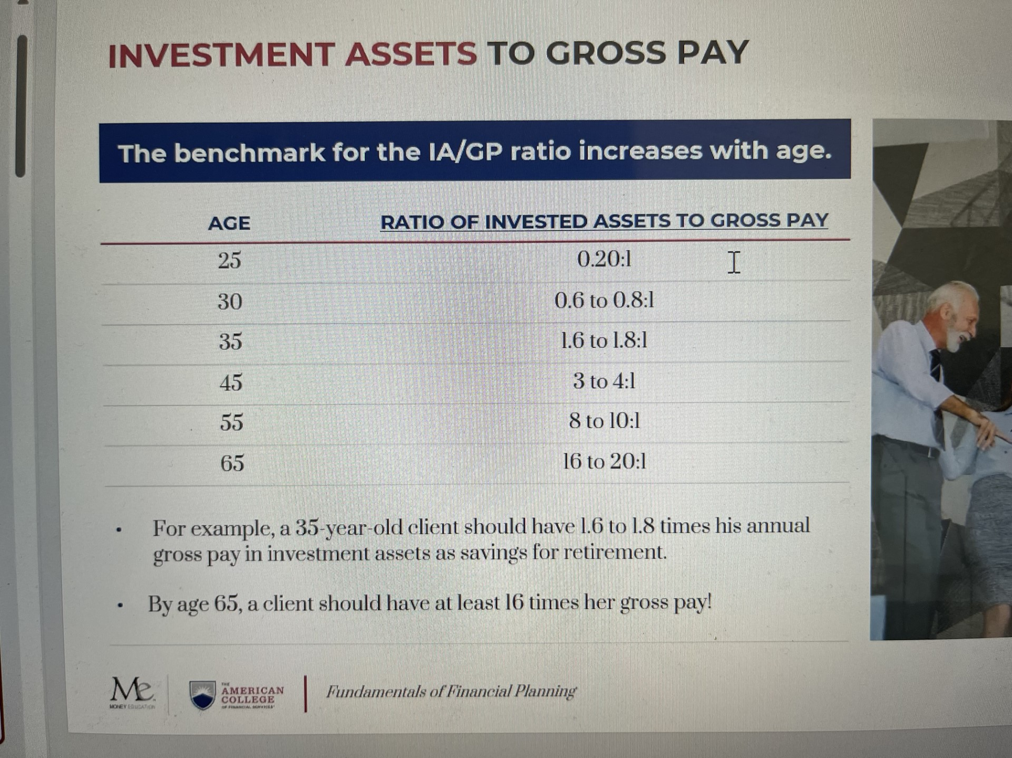

Slide 21

Accumulation.
College Funding.
The average
American carries
$35,457 in student loan debt.*
It’s never too late to start!
*”Consumer Debt Continued to Grow in 2021 Amid Economic Uncertainty” Experian 29 April 2022.
https://www.experian.com/blogs/ask-experian/research/consumer-debt-study/#s2
20
Notes:
We’ll start with college funding. You’re probably aware that college costs are escalating annually. Fortunately, there are many products out there to help you set aside money for college tuition. In fact, there are so many we don’t have time to go into it today. You should take into account any primary sources of funds. For example, savings you have thus far and any funds you anticipate in the future, such as grandparent gifting and other monetary awards your child might receive.
Even if you haven’t started saving for your child’s college education, or you feel that your current rate of saving may not be sufficient, it is not too late to set aside potential other funds to help support your child’s educational future.
Potential funding options are one of the things that we can explore together at a follow-up session.

Slide 22
Retirement planning.
1.
2.
3.
Taxable
Tax Deferred
Tax-Free Income*
Personal Savings
IRA, 401(k), 403(b), SEP, SIMPLE IRA
Roth IRA/401(k)
Cash value life insurance
*Investments or securities related products are offered through properly licensed registered representatives of NYLIFE Securities LLC, member FINRA/SIPC, A Licensed Insurance Agency.
21
Notes:
In planning for retirement, there are various options to consider. Two main categories are tax-deferred and personal savings.
For today’s purposes, we will segment retirement planning options into those regulated/administered by the government (like qualified plans and social security) and vehicles you control (your personal savings).
Tax deferred plans include IRAs and 401(k)s. These are designed to help you accumulate money on a pre-tax basis. This means you don’t pay taxes on the money you set aside in these plans until you take it out. There are usually penalties associated with early withdrawal unless an exception applies. Roth IRA and Roth 401(k)s are retirement plans which offer the benefit of tax-free income if applicable requirements are met. These plans let you set aside money that is tax free when it is withdrawn. Since qualified plans are government-controlled, they determine how much you can contribute.
With personal savings, essentially you are the driver. In most cases you can contribute as much as you want.
Some options for personal retirement savings can include (but are not limited to) annuities, personal savings accounts and other investment vehicles*.

Slide 23
Retirement planning.
Risk Tolerance
Time to retirement
Age 65
Aggressive
Moderate
Conservative
22
Notes:
With personal savings and individual retirement accounts you can choose how you would like to invest. Employer-sponsored plans often have a selection of options to choose from. You may want to consider a mix of solutions based on your risk tolerance and the amount of time you have to save for retirement.
If you would like to get a personalized look at your retirement saving progress, just let me know and we can set something up after the meeting.

Slide 24
Preservation.
The roof of your financial house.
23
Notes:
Now we come to the roof of our financial house—preservation.
As I mentioned earlier, one of our objectives today is to help you understand the benefits of developing good financial habits.
Well, everything we have done thus far in building our financial house is designed to help you achieve this goal.
When you take charge of your financial house by looking at your cash flow, properly preparing for managing the risk areas, and setting aside money for college and retirement, you may begin to start accumulating wealth in order to experience a higher level of financial freedom

Slide 25
Tools to preserve your lifestyle and wealth.
We implement strategies to help you keep more of what you’ve saved.
*”Top 10 Fears of Older Adults in 2022” SeniorLiving.org 28 March 2022 https://www.seniorliving.org/finance/senior-fears-study/
24
Notes:
Preservation is about making sure the money you accumulated for retirement will be there as long as you need it and anything that is left over is distributed as you wished.
(Review Slide)
The largest fear of most retirees is running out of money. The largest fear among 55-64 year olds is not having enough money for retirement.* We have a variety of solutions for that.
Another concern is the orderly distribution of one’s estate after they’re gone.
We’ve been helping people with that for a long time.
Some of these things will become more important the closer you get to retirement.

Slide 26
“Most people don’t plan to fail, they fail to plan.”
25
Notes:
Having a strategy –or blueprint--is the key…
That’s because many of us do not take the time to build a strategy, or if we do, most of us have trouble sticking with it.
In other words, people don’t plan to fail, they fail to plan.
Making a plan is key…

Slide 27
Let’s review the financial house concept.
Your financial house.
26
Notes:
Okay, let’s recap. We have taken you through all the levels of your “Financial House.”
Level one is the foundation where you prepare to manage risks by using emergency savings as well as life, health, disability insurance, and long-term care insurance.
Then, level two: contributions to college funding and retirement plans to help ensure a secure future for yourself and your loved ones.
Finally, level three, where we can make sure your plans come to fruition and try to preserve the assets you worked so hard to build up.
Now, I have only had about 20 minutes with you here today, so we have only scratched the surface on many of these concepts. Still, I hope that you are coming away with a better understanding of how these concepts work and that they got you thinking about the direction in which you want your financial future to go.

Slide 28

Person to person help to craft and execute
Your unique strategy.
27
Notes:
Preparation is key. The first step is to think about your goals and then prioritize them. Next is develop a strategy and action plan. Whatever strategy is developed it is an ongoing process. It’s not about “set-it-and-forget-it.” Things are always changing, things in our control and things outside our control. We have to be able to flex and bend as needed along the way.

Slide 29
Why work with New York Life?
As a New York Life Agent, we… | Why choose New York Life?
Analyze needs and work with your budget to create the perfect strategy for you and your family. Focus on the needs of your unique market to provide sound financial guidance. | New York Life has been protecting our policy holders and keeping their promises since 1845. Highest ratings for financial strength currently awarded to any U.S. life insurance company.
A++ | AAA | Aaa | AA+
Superior | Exceptionally Strong | Exceptional | Very Strong
A.M. Best | Fitch | Moody’s | Standard & Poor’s
Source: Individual independent rating agency commentary as of August 09, 2022.
28
Notes:
At New York Life Insurance Company, every decision we make, every action we take, has one overriding purpose: To be here when you, our policy owners, need us. We have been protecting our policy holders and keeping their promises since 1845.
Financial ratings are important when determining the right options for you. New York Life has the highest financial strength currently awarded to any U.S. life insurance company.
I understand that everyone’s situation is different and needs will vary. We are talking very generally here, but would be happy to talk specifically about your own situation afterwards and help you build a blueprint that works for you. Since we have some time now I can answer some general questions you may have.
(Open up for questions)

Slide 30
Educate yourself.
1.
2.
3.
4.
Think about
Your goals
Prioritize
Your
goals
Develop a strategy and take action
Update and review
your progress at
least once a year
29
Notes:
Take the next step. Start thinking about your goals and what your priorities are. Meet with a financial professional to help look at where you are today, craft a strategy and make recommendations for your specific situation.

Slide 31
Thank
you.
Notes:
Again, thank you for your time to be here and participate in today’s session.
We look forward to seeing you again.
Have a pleasant (day, evening).

